Slide 1
BANK LINE MANEGER
Dr. Mohamed Islam & Eng. Mona Abdelatty
ELC2242– Digital Electronics & Microprocessors
Team 3 – Second Year

Slide 2
TABLE OF CONTENTS
01
02
03
Idea
Circuit & Modules
Simulation
Project General Idea
Verilog & Circuitry
Modelsim testing Simulation

Slide 3
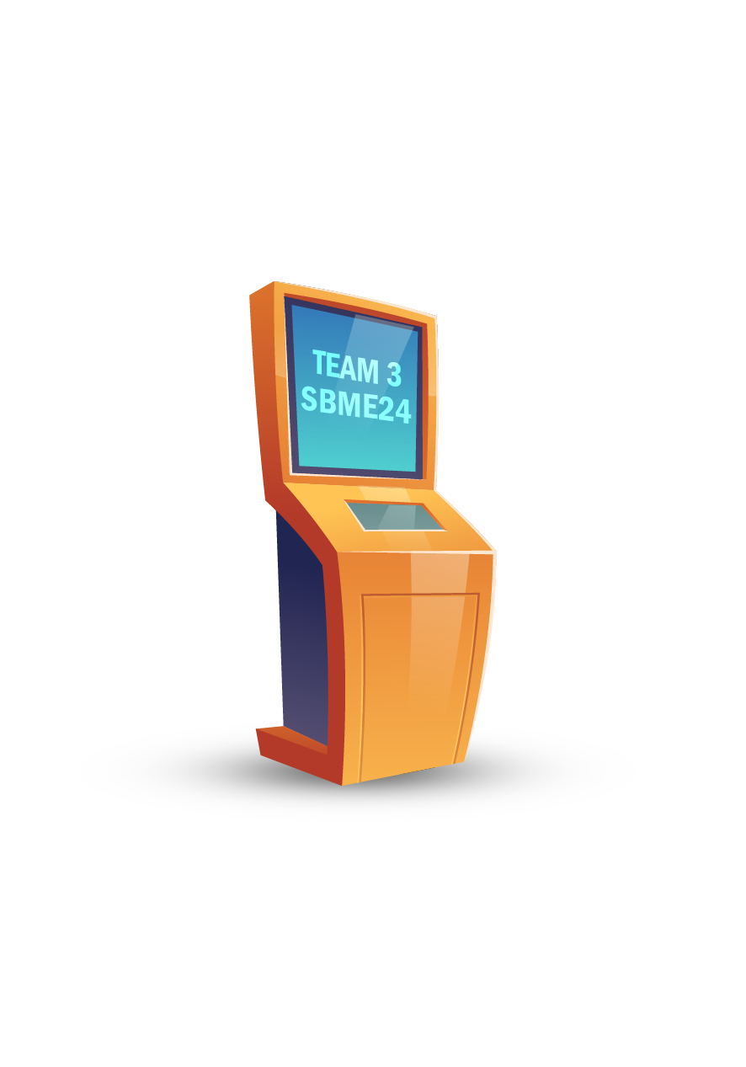
Application
In banks customers are placed in a physical queue to wait for their turn,
There is a machine that regulates and preserve the order of each customer

Slide 4
Implementation
This application is impelemented with a queue using verilog to organize people entry and turns

Slide 5
Circuit & Modules

Slide 6
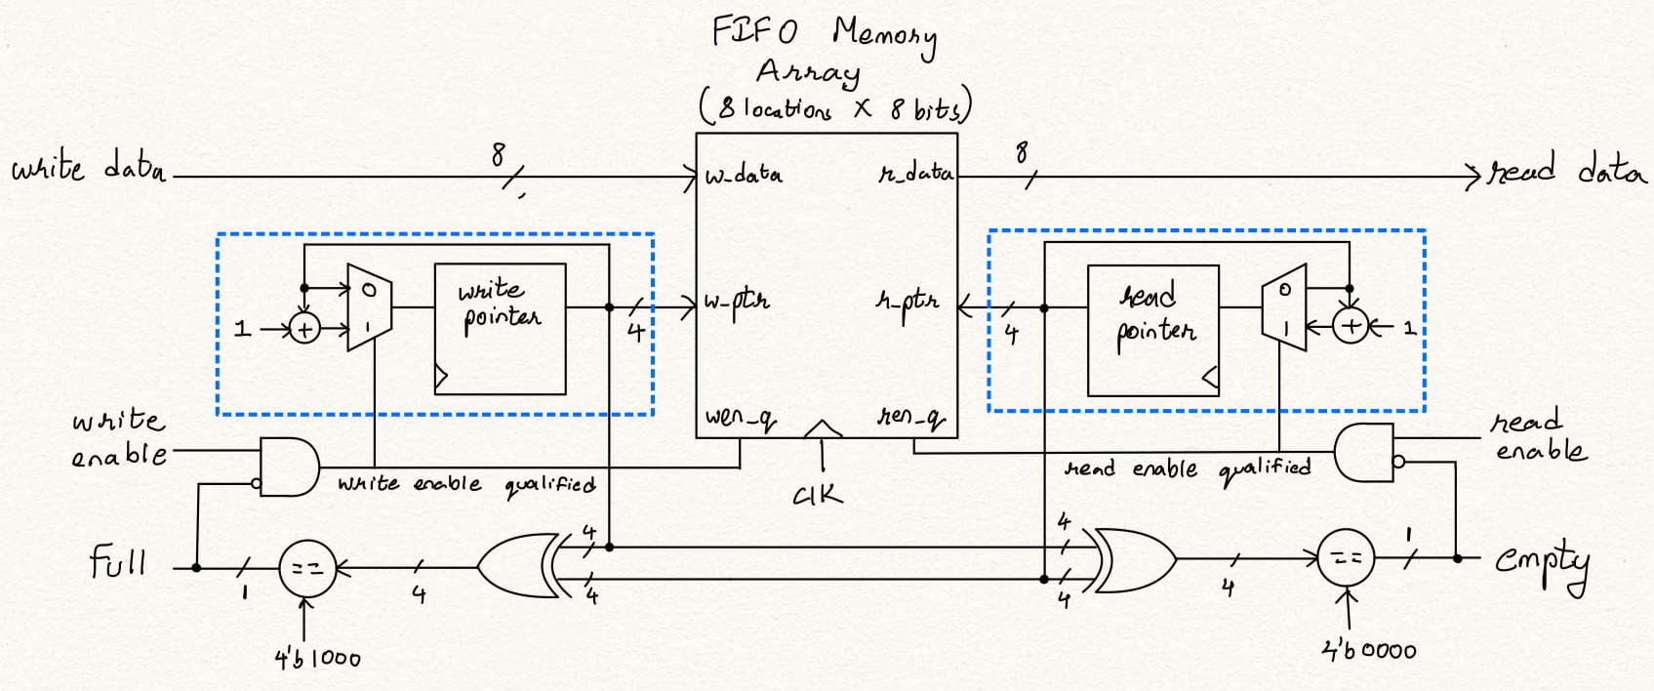

Slide 7
Modules made
WRITE POINTER
MEMORY
READ POINTER
STATE CHECKER
BCD-ENDCODER
7 SEGEMENT DECODER
OUT: Write Pointer
IN: Wr, CLK, REST, full
OUT: dataOut
IN: dataIn, CLK, check
OUT: Read Pointer
IN: Rd, CLK, REST, empty
OUT: full, empty, overflow, underflow
OUT: Binary
IN: Decimal
OUT: 7 Segement
IN: Binary

Slide 8
OUR Contributions
1
2
3
4
Ibrahim Mohamed
Kamel Mohamed
Youssef Shaaban
Youssef Kadry
Sec: 1 B.N: 2
Sec: 2 B.N: 10
Sec: 2 B.N: 57
Sec: 2 B.N: 59
Idea & Presentation
Verilog code
Test Bench Code
Verilog code

Slide 9
THANKS!
Do you have any questions?
Team 3
Second Year
ELC2242– Digital Electronics & Microprocessor
Please keep this slide for attribution
Dr. Mohamed Islam & Eng. Mona Abdelatty

